Slide 1

Slidehood.com

Slide 2
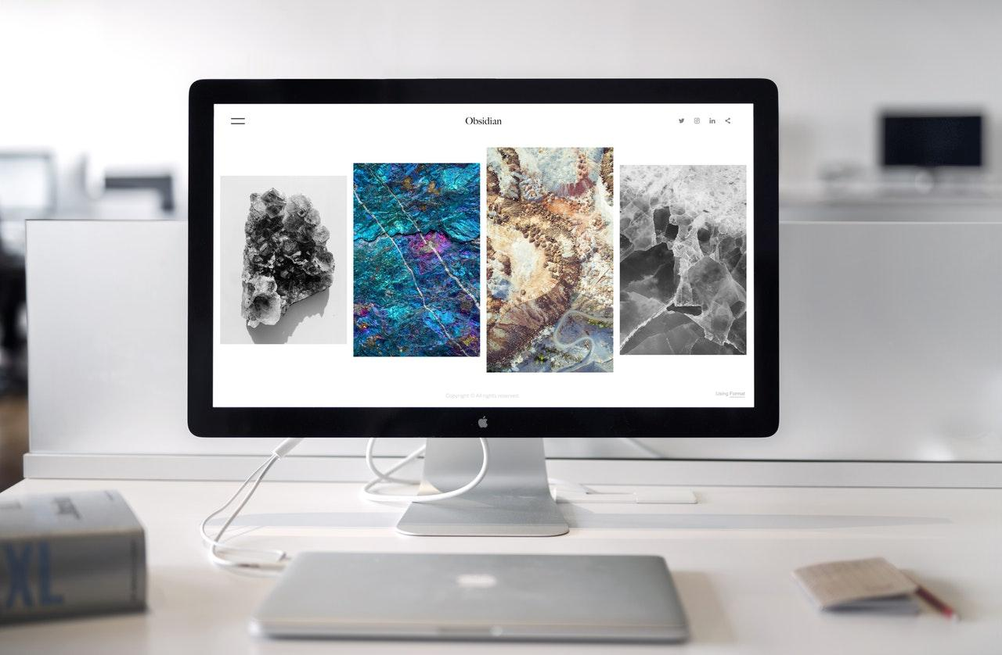


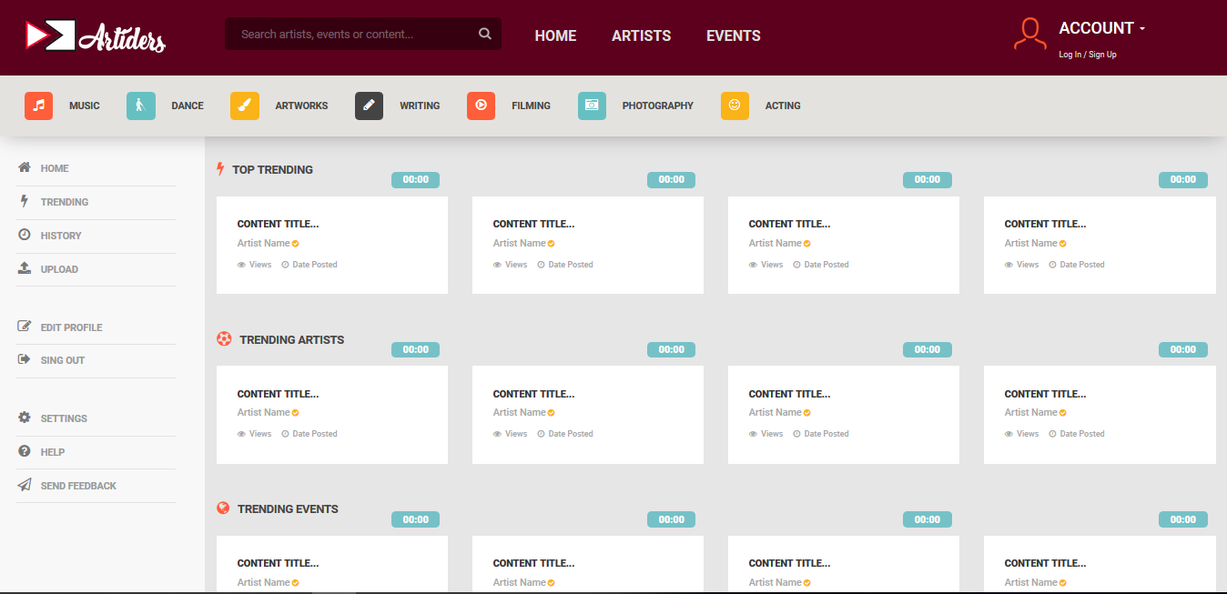
OR

Slide 3

Slidehood.com
Artiders is an online portfolio and content upload portal for the artists from various fields to create a profile/portfolio and showcase their talent in their area of expertise. It also serves as an advertisement platform for users/event organisers who are looking to hire artists for their functions or events. The website will also feature a messaging system through which the users (normal users, artists, event organisers) can communicate with each other.

Slide 4


Slidehood.com

Slide 5

NextSo,
What’s Next?
Slidehood.com

Slide 6

Slidehood.com
Grab the attention of your audience by using icons and impressive
images
Notes:
what’s wrong with all these platforms??

Slide 7

Main Feature
Notes:
talk about artists…..

Slide 8


Secondary Feature
Notes:
talk about artists…..

Slide 9

Features
Notes:
talk about artists…..

Slide 10

Problem Statement
Notes:
talk about artists…..

Slide 11

Problem Statement
Notes:
talk about artists…..

Slide 12

Development Platform

Slide 13

Development Framework

Slide 14

Development IDE

Slide 15

PHP Unit
Testing Environment

Slide 16

Future Ideas

Slide 17
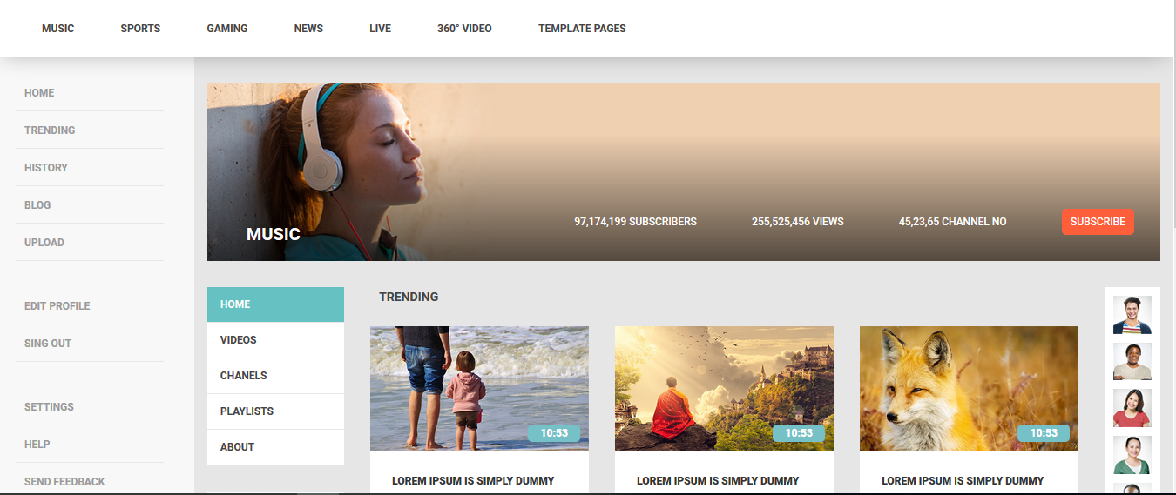
Future Plans

Slide 18
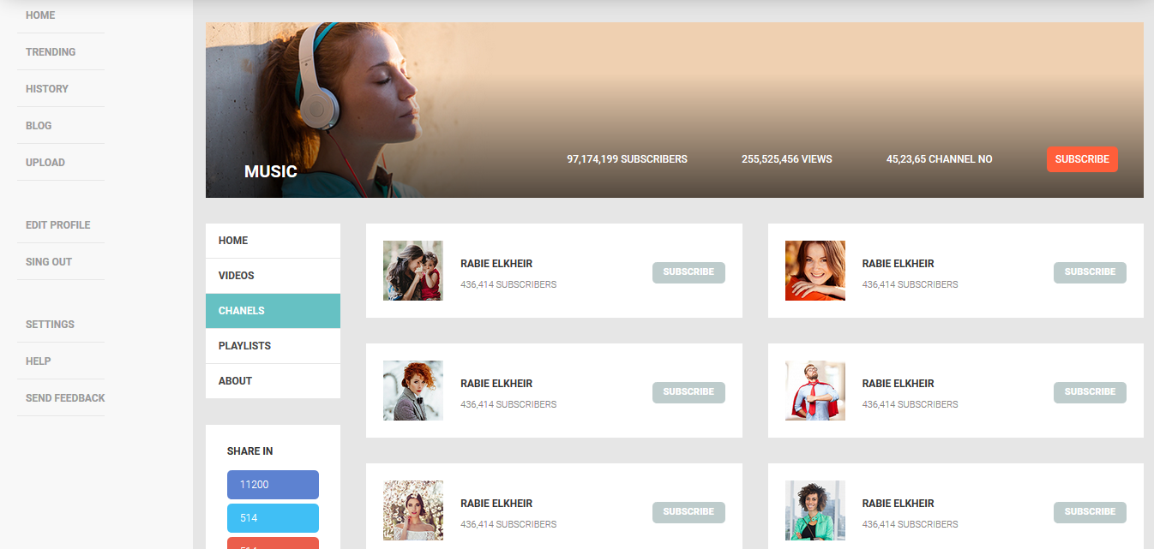
Artist Chanel Page

Slide 19
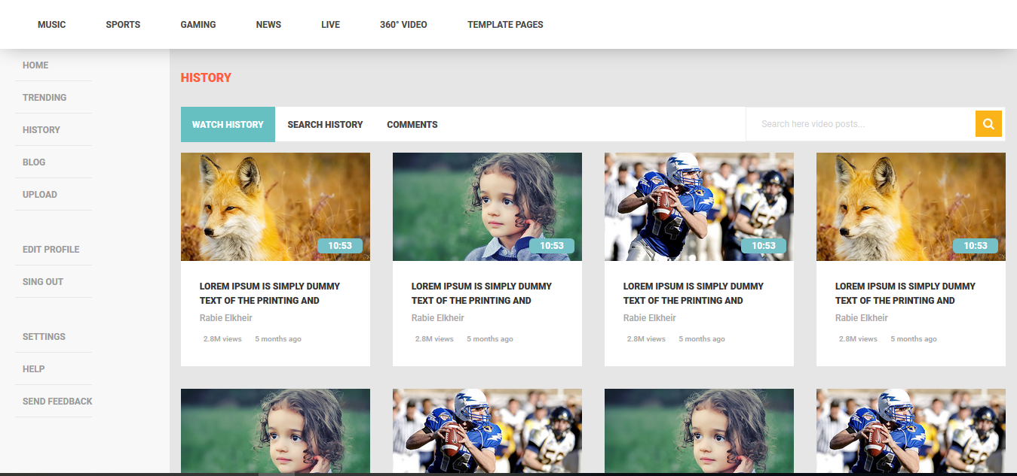
History Page

Slide 20
History Page

Slide 21
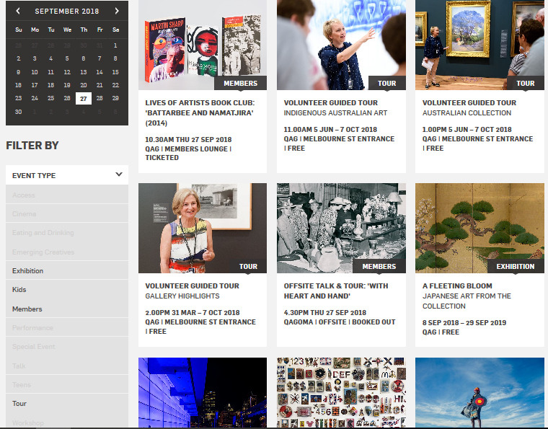
Events Page

Slide 22

Thank you

Slide 23


